Slide 1
Indexing and Hashing
Prepared By: Amrin Shaikh

Slide 2
outline
Basic Concepts
Ordered Indices, B+-Tree Index Files, B+-Tree Extensions
Multiple-Key Access, Static Hashing, Dynamic Hashing
Comparison of Ordered Indexing and Hashing, Bitmap Indices
Index Definition in SQL

Slide 3
Why Indexing & Hashing?
Some Queries return only small portion of records from file or only one record from a file.
It is inefficient for the system to read every record.
Is there any way to create an index page like our books. Whenever I want to search about transaction processing. I will go to index and search on which page that chapter starts. so, it will be easy for me to search rather than checking all pages.

Slide 4
Database grows day by day. You cant save that all data’s (all records) on the same data block because they are having fix size.
So, Can I say that my data resides on number of data blocks?
At the time of searching database system has to copy data block into main memory and search your queried data resides in that block or not. Likewise It has to copy all data block’s one by one just to retrieve 1 or n records.

Slide 5
Indexing
To retrieve data of an employee having e_id=101 . The database system will look up an index to find on which disk block corresponding record resides and then fetch the disk block to get the appropriate record.
Indexing mechanisms used to speed up access to desired data.
So, how to create indexing?

Slide 6
Search Key - attribute to set of attributes used to look up records in a file.
An index file consists of records (called index entries or index record) of the form
Index files are typically much smaller than the original file
Two basic kinds of indices:
Ordered indices: search keys are stored in sorted order
Hash indices: search keys are distributed uniformly across “buckets” using a “hash function”.
Search key value
Pointer to record
Index entry/index record

Slide 7
From above two techniques which one to choose?
Each techniques have evaluated on the basis of below factors.
Access type
Access time
Insertion time
Deletion time
Space overhead

Slide 8
Ordered indices
In an ordered index, index entries are stored sorted on the search key value.
Primary index: in a sequentially ordered file, the index whose search key specifies the sequential order of the file.
Also called clustering index
The search key of a primary index is usually but not necessarily the primary key.
[in a sequentially ordered file (e.g. the index whose search key specifies the sequential order of the file]
Secondary index: an index whose search key specifies an order different from the sequential order of the file. Also called non-clustering index.
[an index whose search key is different from the sequential order of the file ]
Index-sequential file: ordered sequential file with a primary index.

Slide 9
Types of ordered indices
Dense indices
Sparse indices

Slide 10
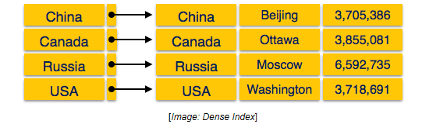
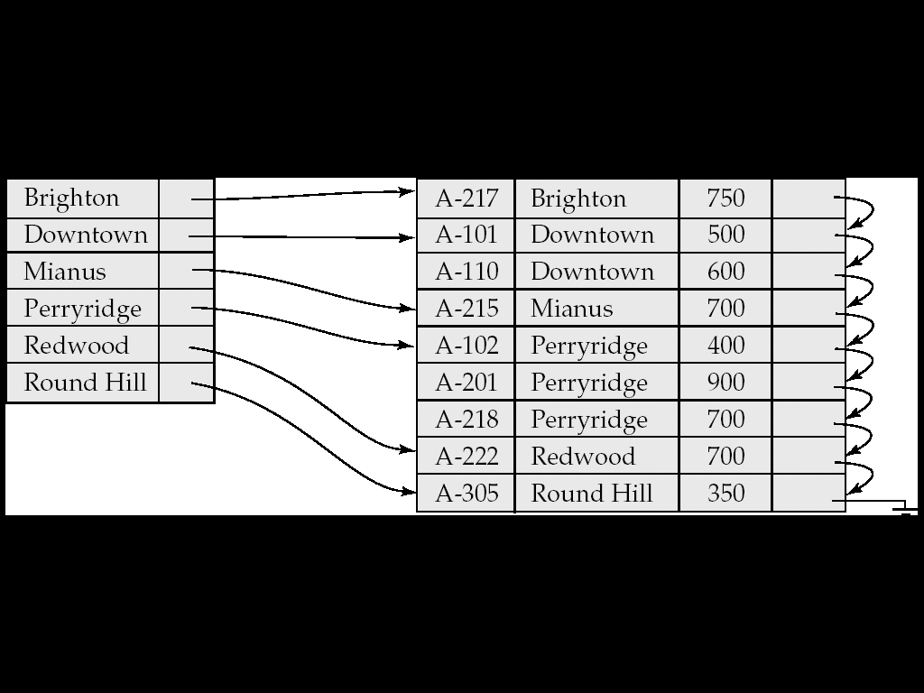
Dense indices
Dense index —there is an index record for every search key value in the database.
This makes searching faster but requires more space to store index records itself.
Index record contains search key value and a pointer to the actual record on the disk.

Slide 11
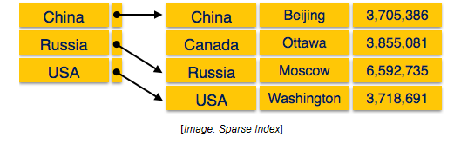
Sparse indices
Sparse Index: contains index records for only some search-key values.
Applicable when records are sequentially ordered on search-key
To locate a record with search-key value K we:
Find index record with largest search-key value < K
Search file sequentially starting at the record to which the index record points
index records are not created for every search key.
An index record here contains search key and actual pointer to the data on the disk.
To search a record we first proceed by index record and reach at the actual location of the data.
If the data we are looking for is not where we directly reach by following index, the system starts sequential search until the desired data is found.

Slide 12
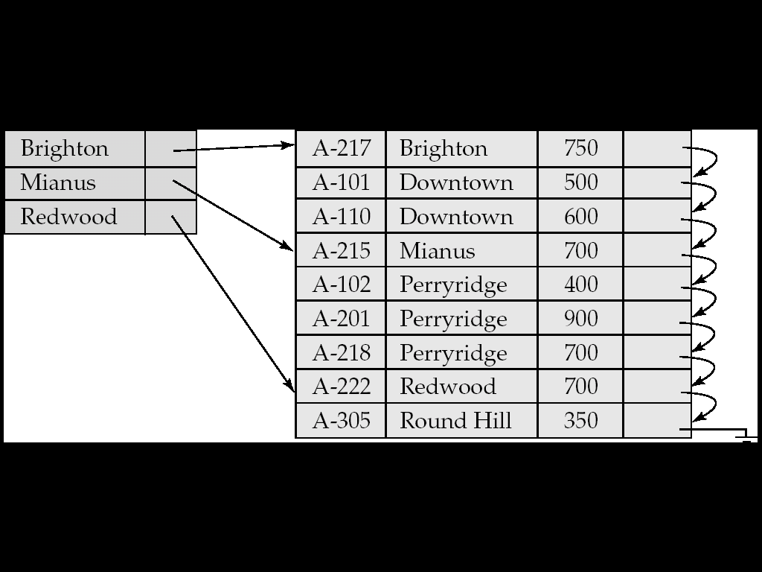

Slide 13
Index update: record insertion
Perform a lookup using the key value from inserted record
Dense indices – if the search-key value does not appear in the index, insert it.
Sparse indices – if index stores an entry for each block of the file, no change needs to be made to the index unless a new block is created.
If a new block is created, the first search-key value appearing in the new block is inserted into the index.

Slide 14
Index update: record deletion
If deleted record was the only record in the file with its particular search-key value, the search-key is deleted from the index also.
Dense indices – deletion of search-key: similar to file record deletion.
Sparse indices –
if deleted key value exists in the index, the value is replaced by the next search-key value in the file (in search-key order).
If the next search-key value already has an index entry, the entry is deleted instead of being replaced.

Slide 15
Sparse v/s Dense
Less space
Less maintenance overhead for insertion and deletion
Generally slower than dense index for locating records.
Good tradeoff: sparse index with an index entry for every block in file, corresponding to least search-key value in the block.

Slide 16
Problems
Index records are comprised of search-key value and data pointers.
This index itself is stored on the disk along with the actual database files.
As the size of database grows so does the size of indices.
There is an immense need to keep the index records in the main memory so that the search can speed up.
If single level index is used then a large size index cannot be kept in memory as whole and this leads to multiple disk accesses.

Slide 17
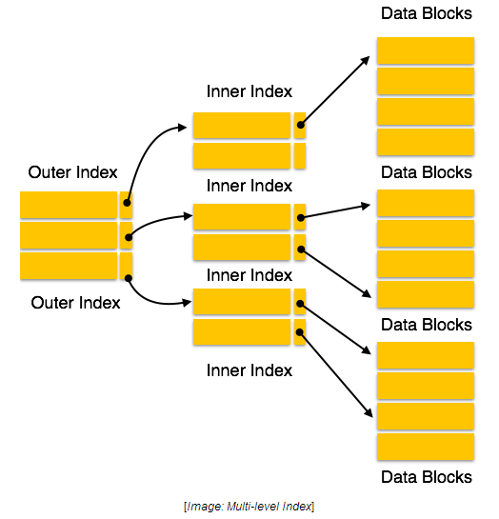
Solution: multi level index
Multi-level Index helps breaking down the index into several smaller indices in order to make the outer most level so small that it can be saved in single disk block which can easily be accommodated anywhere in the main memory.

Slide 18
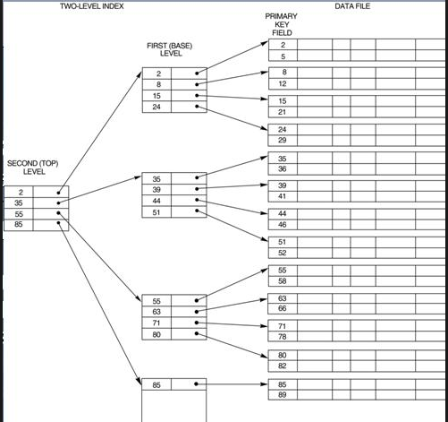

Slide 19
Another problem
Often one wants to find all records whose values in a certain field (which is not the search key of the primary index) satisfy some condition
{ Example 1: In the EMPLOYEE database, records are stored sequentially by EmpNo, we want to find employees working in a particular department.
{ Example 2: as above, but we want to find all employees with a specified salary or range of salary

Slide 20
Secondary indices
One can specify a secondary index with an index entry for each search key value;
index entry points to a bucket, which contains pointers to all the actual records with that particular search key.

Slide 21
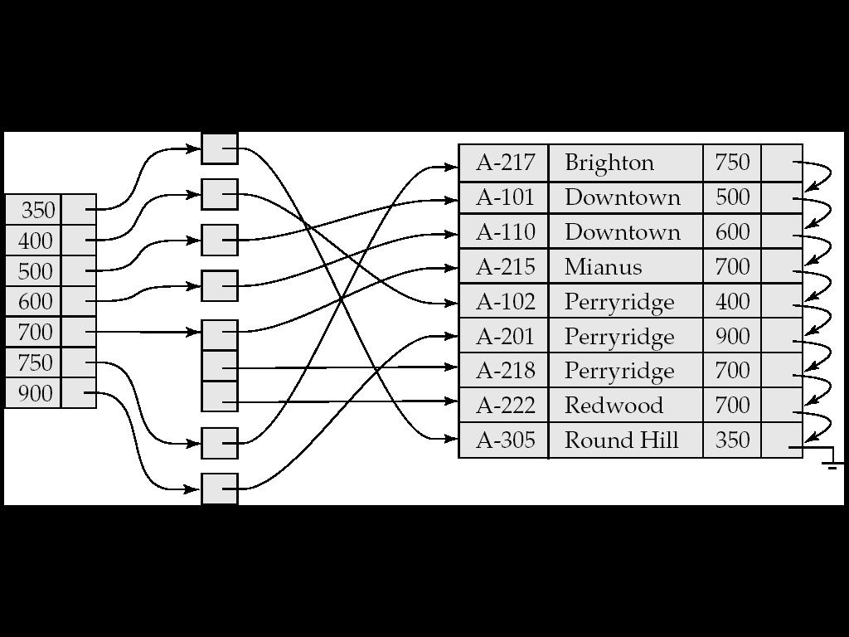
Secondary indices

Slide 22
Primary v/s secondary indices
Secondary indexes have to be dense
Indexes offer substantial benefits when searching for records
When a record file is modified (e.g., a relation), every index on that file must be updated. Updating indexes imposes overhead on database performance.
Sequential scan using primary index is efficient, but a
sequential scan using a secondary index is expensive (each record access may fetch a new block from disk)

Slide 23
A search key containing more than one attribute is referred to as composite search key.
Main disadvantage of the index-sequential file organization is that performance degrades as the file grows and File reorganizations.

Slide 24
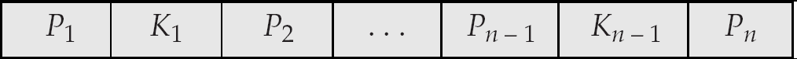
B+ tree node structure
Typical node
K_{i} are the search-key values
P_{i} are pointers to children (for non-leaf nodes) or pointers to records or buckets of records (for leaf nodes).
The search-keys in a node are ordered
K₁ < K₂ < K₃ < . . . < K_{n–1}

Slide 25
Insertion into B+ tree
While inserting values into node. if node is full then follow the following two rules.
If node is leaf then break down the node into two partitions.
The first partition should hold ceil of (n-1)/2 key values.
Second partition should hold rest of the key values where n is number of pointers.
Copy of smallest key element from second partition to parent node.
If node is non leaf node then break down the node into two partitions.
The first partition should hold ceil of(n/2)-1 key values
Second partition can hold rest of the key values where n is number of pointers
Move the smallest element from second partition to parent node.

Slide 26
Example
Insert 2,5,7,10,13,16,20,22,23,24
Assume n=4 or degree=4;
Insert 2:
Insert 5:
2
2
5

Slide 27
Insert 7
Insert 10:
No space how can I insert?
2
5
7
2
5
7

Slide 28
An initial node in B+ tree is leaf node.
If node is leaf then break down the node into two partitions.
The first partition should hold ceil of (n-1)/2 key values.
Second partition should hold rest of the key values where n is number of pointers.
Copy of smallest key element from second partition to parent node.
7
2
5
7
10

Slide 29
Insert 13
Insert 16
7
2
5
7
10
13

Slide 30
7
10
13
7
10
13
16
7
13
2
5
7
10
13
16

Slide 31
Insert 20:
Insert 22:
7
13
2
5
7
10
13
16
20
7
13
20
2
5
7
10
13
16
20
22

Slide 32
Insert 23:
Insert 24:
7
13
20
2
5
7
10
13
16
20
22
23

Slide 33
20
22
23
overflow root
7
13
20
20
22
23
24

Slide 34
Apply Rule:2
If node is non leaf node then break down the node into two partitions.
The first partition should hold ceil of(n/2)-1 key values
Second partition can hold rest of the key values where n is number of pointers
Move the smallest element from second partition to parent node.
Ceil of (n/2)-1=Ceil of(4/2)-1=2-1=1

Slide 35
13
7
20
23
2
5
7
10
13
16
20
22
23
24

Slide 36
B+ tree deletion
When number of search key values < (n-1)/2 nothing to do.
Leaf node:
Redistribute to sibling
Right node greater than left node
Replace the between value in parent by their smallest value of the right node.
Merge
Move all values , pointers to the left node
Remove the between value in parent

Slide 37
Non leaf node
Redistribute to sibling
Through parent
Right node not less than left node.
Merge
Bring down the parent
Move all values , pointers to left node
Delete the right node and pointers in parent.

Slide 38
Leaf node deletion
13
18
9
10
13
14
16
Delete 10
14
18
9
13
14
16

Slide 39
Non leaf node deletion
5
20
3
8
1
3

Slide 40
Delete 3
20
5
8
1

Slide 41
17
5
13
24
30
19
20
22
24
27
29
33
34
38
39

Slide 42
Delete 19
Calculate (n-1)/2=(5-1)/2=2
After deleting 19, 2 elements will be there so not to do
24
30
20
22
24
27
29
33
34
38
39

Slide 43
Delete 20 only 1 element will be there which is not half full
deleting at leaf node value
Apply leaf level deletion rule
27
30
22
24
27
29
33
34
38
39

Slide 44
Delete 24
29
30
22
27
29
33
34
38
39

Slide 45
30
22
27
29
33
34
38
39

Slide 46
17
5
13
30
22
27
29
33
34
38
39

Slide 47
5
13
17
30
22
27
33
34
38
39

Slide 48
Multiple key Access
Use multiple indices for certain types of queries.
Example: select account_number from account where branch_name = “Perryridge” and balance = 1000
Possible strategies for processing query using indices on single attributes:
Use index on to find accounts with balances of $1000; test branch_name = “Perryridge”.
Use index on to find accounts with branch_name = “Perryridge”, test balance = 1000 .

Slide 49
Indices on Multiple Keys
We have table with 3 columns
table test with columns id, first, second
then we have two indexes first_second_idx (first, second) first_idx (first)
then if we use statement (1)
select * from test where first = 'whatever';
query planner should use index first_idx ( 'whatever' value is for example 5% of all records). It's faster because index is smaller so there is less read.
For query (2)
select * from test where first = 'whatever' and second = 'something‘;
it's obvious that index first_second_idx will be used But if we remove first_idx in both queries planer should use first_second_idx.
If there is no index for this table full table scan will be triggered.

Slide 50
B-Tree Index Characteristics
A B-tree index can be used for column comparisons in expressions that use the =, >, >=, <, <=, or BETWEEN operators. The index also can be used for LIKE comparisons if the argument to LIKE is a constant string that does not start with a wildcard character.
SELECT * FROM tbl_name WHERE key_col LIKE 'Patrick%';
SELECT * FROM tbl_name WHERE key_col LIKE 'Pat%_ck%';
The following SELECT statements do not use indexes
SELECT * FROM tbl_name WHERE key_col LIKE '%Patrick%';
SELECT * FROM tbl_name WHERE key_col LIKE other_col;

Slide 51
Hash Index Characteristics
They are used only for equality comparisons that use the = or <=> operators (but are very fast). They are not used for comparison operators such as < that find a range of values. Systems that rely on this type of single-value lookup are known as “key-value stores”.
The optimizer cannot use a hash index to speed up ORDER BY operations. (This type of index cannot be used to search for the next entry in order.)
MySQL cannot determine approximately how many rows there are between two values (this is used by the range optimizer to decide which index to use).
Only whole keys can be used to search for a row. (With a B-tree index, any leftmost prefix of the key can be used to find rows.)

Slide 52
B-Tree Indexes are suitable for range queries/range scans since the keys are ordered. For example, the following types of queries will benefit from a typical B-Tree Index structure on “SALARY” column.
“SELECT * FROM T WHERE SALARY>5000 AND SALARY<10000”
“SELECT * FROM T WHERE SALARY>5000”;
The result set for such queries will contain rows in sorted order since the index stores the keys in order.
The above point about suitability of B-Tree Indexes for range scans is valid for both UNIQUE and NON-UNIQUE Indexes.
It is not the case that B-Tree Indexes are not suitable point lookups. We can definitely use B-Tree indexes for point lookups but hash indexes are usually more efficient for such workloads.

Slide 53
Hashing

Slide 54
Hashing
Disadvantage of sequential file organization is that we must access an index structure to locate data, or must use binary search and that results in more IO operation.
Hashing is the transformation of a string of characters into a usually shorter fixed-length value or key that represents the original string.
File organization based on hashing allow us to avoid accessing an index structure.

Slide 55
Types of Hashing
Static Hashing
Dynamic Hashing

Slide 56
Static Hashing
A bucket is a unit of storage containing one or more records (a bucket is typically a disk block).
In a hash file organization we obtain the bucket of a record directly from its search-key value using a hash function.
In a hash index organization we organize the search keys, with their associated pointers into a hash file structure.
Hash function h is a function from the set of all search-key values K to the set of all bucket addresses B.
Hash function is used to locate records for access, insertion as well as deletion.
Records with different search-key values may be mapped to the same bucket. thus entire bucket has to be searched sequentially to locate a record.

Slide 57
Worst scenario is when hash function maps all possible search key value (SKV) to the same bucket.
Ideal hash function distributes the search key uniformly across all the buckets.
At design time we don’t know which SKV will be stored in file.
So we have to choose a hash function that assign SKV to bucket in such a way that the distribution has these qualities.
The distribution is Uniform
The distribution is random

Slide 58
For a University database create department wise bucket
For emp file create hash function that maps name’s beginning with i^{th} character will be in i^{th} bucket.(for that create 26 bucket’s per alphabet). But it fails to provide uniform distribution.
Create hash function on salary attribute. In our department min_sal=4000 and max_sal is 13000 then can we design hash function in a 1000 salary gap. It provides uniform distribution but not random. Some buckets can have more records then others.
If search key occurs in only a small fraction of records can be called as random distribution.

Slide 59
Typical hash function perform computation on the internal binary machine representation of characters in the search key.
Simple hash function of this type first computes the sum of the binary representation of the characters of a key, then returns the sum modulo the number of buckets.

Slide 60
Example
Emp_id | Emp _name
21 | Smith
37 | Ron
57 | Saira
11 | Samir
22 | Mittal
43 | Janvi
32 | Delnaz
Create Hash Function h which will sum digits of
attribute Emp_id and number of buckets=3. assume bucket size=2
Emp_id | Emp _name
21 | Smith | (2+1)%3=0
37 | Ron | (3+7)%3=1
57 | Saira | (5+7)%3=0
11 | Samir | (1+1)%3=2
22 | Mittal | (2+2)%3=1
43 | Janvi | (4+3)%3=1
32 | Delnaz | (3+2)%3=2

Slide 61
Bucket 0
21 | Smith
57 | Saira
Where to insert 43 Janvi
Bucket 1
22 | Mittal
37 | Ron
Bucket 2
11 | Samir
32 | Delnaz

Slide 62
Bucket Overflow
Bucket overflow can occur because of
Insufficient buckets: The number of Buckets NB > ((number of records that will be stored NR)/(number of records that will fit in bucket FR))
In our example (3>(7/2)) is not correct.
Bucket Skew: some buckets are overflowed though others are having space.
This can occur due to two reasons:
multiple records have same search-key value
chosen hash function produces non-uniform distribution of key values
Although the probability of bucket overflow can be reduced, it cannot be eliminated; it is handled by using overflow buckets.

Slide 63
The probability of bucket overflow is reduced.
The number of bucket is chosen to be
NB =(NR/FR)*(1+d), where d id fudge factor having value around 0.2
According to above example NB=(7/2)*(1.2)=3.5*1.2=4.2
We handle bucket overflow by overflowed bucket.

Slide 64
Bucket 0
21 | Smith
57 | Saira
Bucket 1
22 | Mittal
37 | Ron
Bucket 1
43 | Janvi
Overflowed Bucket for Bucket1
Bucket 2
11 | Samir
32 | Delnaz

Slide 65
If overflow bucket is full then system provides another overflow bucket and so on…
All overflow buckets are chained together in linked list.
Overflow handling using such linked list is called overflow chaining.
Open hashing:
Set of bucket is fixed.
There are no overflow chains.
If a bucket is full the system inserts records in some other bucket in the initial set of bucket B.(use next bucket in cyclic order)that has space called linear probing
Used to construct symbol table for compiler and assembler.
Deletion under open hashing is troublesome
Closed hashing:
Preferable for database systems.

Slide 66
Hashing is not only for file organization but also for index structure creation.
Hash index organizes the search key , with their associated pointer into a hash file structure.

Slide 67
Hash index on a search key Eid of emp file
Emp_id | Emp _name
21 | Smith
37 | Ron
57 | Saira
11 | Samir
22 | Mittal
43 | Janvi
32 | Delnaz
Bucket 0
21
57
Bucket 1
22
37
Bucket 1
43
Bucket 2
11
32

Slide 68
Dynamic Hashing
Database grow over large time. so it’s a big problem to set number of buckets.
If we are choosing hashing for such a database we are having below 3 options.
Choose hash function based on current file size where performance degrade as file grows.
Choose a hash function based on anticipated file size where a significant amount of space may be wasted.
Periodically reorganize the hash structure in response to file growth.
Several dynamic hashing technique allow the hash function to be modified dynamically to accommodate the growth or shrinkage of database.
One of the technique is Extendable hashing.

Slide 69
Extendable hashing copes with changes in database size by splitting and coalescing buckets as database grows.
Choose a hash function h with desirable properties like uniformity and randomness.
This hash function generates values over a relatively large range- namely x bit binary integer. Typical value for x is 32.
Don’t create bucket for each hash value. Because to create 2^x bucket is unreasonable.
Create bucket on demand.

Slide 70
We do not use entire x bit of hash value initially. At any point we use I bits where 0<=i<=x
This I bits are used as an offset into an additional table of bucket addresses.
The value of I grow and shrinks with the size of database.

Slide 71
i
I bits of the hash value h(k) are required to determine the correct bucket for k
Bucket Address Table

Slide 72
Emp file data
Eid | Name | Dept_name | salary
10101 | Jay | CS | 6500
12121 | Sonali | Finance | 9000
15151 | Mohit | Music | 4000
22222 | Elin | Physics | 9500
32343 | James | History | 6000
33456 | Goldy | Physics | 8700
45565 | Ket | CS | 7500
83821 | Banny | CS | 9200

Slide 73
Applying Hash function for dept_name
Dept_name h(dept_name)
Biology 0010
CS 1111
EE 0100 Finance 1010
History 1100
Music 0011
Physics 1001
I have assumed here only 4 bit hash value from book rather than 32bit.
Assumed bucket can hold only two records.

Slide 74
Initially assume file is empty
i
i_{j}
Bucket Address Table
Bucket 1

Slide 75
Insert 10101 Jay CS 6500
0
0
10101 | Jay | CS | 6500
Bucket Address Table
Bucket 1

Slide 76
Insert 12121 Sonali Finance 9000
0
0
10101 | Jay | CS | 6500
12121 | Sonali | Finance | 9000
Bucket Address Table
Bucket 1

Slide 77
Insert 15151 Mohit Music 4000
0
0
10101 | Jay | CS | 6500
12121 | Sonali | Finance | 9000
Bucket Address Table
Bucket 1
Bucket Overflow arise. Since i=i₀
Increase number of bits =0+1=1
Number of buckets will be 2^1=2
Increase in number of bits will double the size of bucket address table.

Slide 78
Hash value beginning with 0
1
1
15151 | Mohit | Music | 4000
1
Hash value beginning with 1
10101 | Jay | CS | 6500
12121 | Sonali | Finance | 9000
Bucket Address Table

Slide 79
Insert 22222 Elin Physics 9500 hash value starts from 1
Hash value beginning with 0
1
1
15151 | Mohit | Music | 4000
1
Hash value beginning with 1
10101 | Jay | CS | 6500
12121 | Sonali | Finance | 9000
Bucket Address Table
Bucket Overflow arise. Since i=i₀
Increase number of bits =1+1=2
Increase in number of bits will double the size of bucket address table.

Slide 80
Hash value beginning with 0
1
2
15151 | Mohit | Music | 4000
2
Hash value beginning with 10
12121 | Sonali | Finance | 9000
22222 | Elin | Physics | 9500
Bucket Address Table
2
Hash value beginning with 11
10101 | Jay | CS | 6500

Slide 81
Insert 32343 James History 6000 hash value starts from 11
Hash value beginning with 0
1
2
15151 | Mohit | Music | 4000
2
Hash value beginning with 10
12121 | Sonali | Finance | 9000
22222 | Elin | Physics | 9500
Bucket Address Table
2
Hash value beginning with 11
10101 | Jay | CS | 6500
32343 | James | History | 6000

Slide 82
Insert 33456 Goldy Physics 8700 hash value starts from 10
Bucket Overflow arise. Since i=i₀
Increase number of bits =2+1=3
Increase in number of bits will double the size of bucket address table.

Slide 83
3
1
Hash value beginning with 0
15151 | Mohit | Music | 4000
3
Hash value beginning with 100
22222 | Elin | Physics | 9500
33456 | Goldy | Physics | 8700
3
Hash value beginning with 101
12121 | Sonali | Finance | 9000
Bucket Address Table
2
Hash value beginning with 11
10101 | Jay | CS | 6500
32343 | James | History | 6000

Slide 84
3
1
Hash value beginning with 0
15151 | Mohit | Music | 4000
3
Hash value beginning with 100
22222 | Elin | Physics | 9500
33456 | Goldy | Physics | 8700
3
Hash value beginning with 101
12121 | Sonali | Finance | 9000
Bucket Address Table
3
Hash value beginning with 111
Insert 45565 Ket CS 7500 hash value starts from 11
10101 | Jay | CS | 6500
45565 | Ket | CS | 7500
3
Hash value beginning with 110
32343 | James | History | 6000

Slide 85
Insert 83821 Banny CS 9200 hash value starts from 111

Slide 86
3
1
Hash value beginning with 0
15151 | Mohit | Music | 4000
3
Hash value beginning with 100
22222 | Elin | Physics | 9500
33456 | Goldy | Physics | 8700
3
Hash value beginning with 101
12121 | Sonali | Finance | 9000
Bucket Address Table
3
Hash value beginning with 111
3
10101 | Jay | CS | 6500
45565 | Ket | CS | 7500
83821 | Banny | CS | 9200
3
Hash value beginning with 110
32343 | James | History | 6000

Slide 87
Advantage
Advantage of extendable hashing is that performance doesn’t degrade as file grows.
Minimal space overhead
Bucket address table incurs additional overhead. It contains one pointer for each hash value for the current prefix length.
No buckets needs to be reserved for future growth. Buckets can be allocated dynamically

Slide 88
Disadvantages
Lookup involves an additional level of indirection. Since the system must access the bucket address table before accessing the bucket itself.
Minor effect on performance

Slide 89
Ordered Indexing | Hashing
Addresses in the memory are sorted for key value. This key value can be primary key or any other column in the table. | Addresses are generated using hash function on the key value. This key value can be primary key or any other column in the table.
Performance of this method comes down as the data increases in the file. Since it stores the data in a sorted form, when there is insert/delete/update operation, an extra effort to sort the record is needed. This reduces its performance. | Performance of dynamic hashing will be good when there is a frequent addition and deletion of data. But if the database is very huge, maintenance will be costlier. Static hashing will be good for smaller databases where record size id previously known. If there is a growth in data, it results in serious problems like bucket overflow.
There will be unused data blocks due to delete/update operation. These data blocks will not be released for re-use. Hence periodic maintenance of the memory is required. Else, memory is wasted and performance will also degrade. Also it will be cost overhead to maintain memory. | In both static and dynamic hashing, memory is well managed. Bucket overflow is also handled to better extent in static hashing. Data blocks are designed to shrink and grow in dynamic hashing. But there will be an overhead of maintaining the bucket address table in dynamic hashing when there is a huge database growth.
Preferred for range retrieval of data- that means when there is retrieval data for particular range, this method is best suited. | This method is suitable to retrieve a particular record based on the search key. But it will not perform better if the hash function is not on the search key.

Slide 90
Comparison of Ordered Indices and Hashing
If all the 3 rows are stored in different disk blocks, then a hash index will require 3 I/Os to fetch result set. On the other hand, a 3 level B-Tree Index will require 6 I/Os : root block + branch block + leaf block + 3 I/Os on respective blocks whose information was retrieved from leaf block.

Slide 91
Comparison of Ordered Indexing and Hashing
ordered indexing is used unless it is known in advance that range queries will be infrequent
Hash organizations are particularly useful for temporary files created during query processing, if lookups on a key value are required and no ranges queries will be performed.

Slide 92
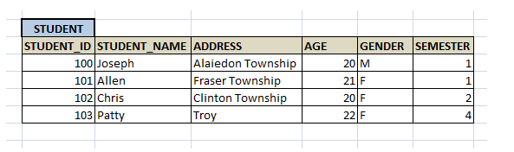
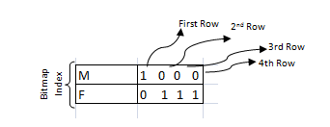
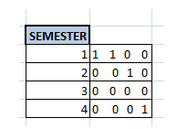
Bitmap Indices

Slide 93
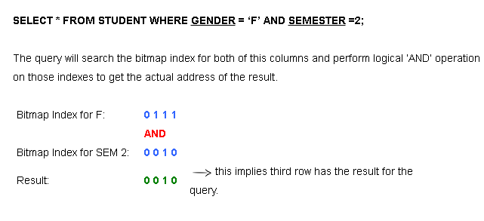

Slide 94
Advantages of Bitmap Indices
As we have seen already, this method helps in faster retrieval of the records when there are less cardinality columns and those columns are most frequently used in the query. This method is efficient even if we have very big table.
This method is more efficient when the columns have least involved in insert/update/delete operations.
It allows to combine multiple bitmap indices together to fire the query as we have seen in above examples

Slide 95
Disadvantages of Bitmap Indices
They are not suitable for small tables. In small tables, DBMS will force to use full table scan instead of using bitmap index.
When there is multiple insert/update/delete on the table from different users, it may cause deadlock on the tables. It will take time to perform the DML transaction and then to update the bitmap index. Hence when there is multiple DML transaction from different users, it will not be able perform transaction quickly, and causing the deadlock.
When there is large number of records, there is an overhead to maintain this bitmap indexes. Each time a new record is entered, we have to modify the bitmap index throughout, which is a tedious and time consuming.

Slide 96
Bitmap index in sql
CREATE BITMAP INDEX Index_Name ON Table_Name (Column_Name);
Our example above for creating bitmap index for Gender and Semester can be written as follows:
CREATE BITMAP INDEX IDX_GENDER ON STUDENT (GENDER);
CREATE BITMAP INDEX IDX_ SEMESTER ON STUDENT (SEMESTER);

Slide 97
Index Definition in SQL
Creating an index:
CREATE INDEX <index-name> ON <relation-name> (<attribute-list>)
Example:
CREATE INDEX branch-index ON branch (branch-name)
Deleting an index:
DROP INDEX <index-name>

Slide 98
Thank You

